Slide 1
The Abyss Usability Test
SMU Main Campus 12/8/14

Slide 2
Playtest
26 Testers
SMU Main Campus, Hughes-Trig Student Center
65% Male

Slide 3
Playtesters
Primarily Console gamers with PC and Casual not far behind. Few Non-Gamers
Majority of players had played shooting based games and some played Shoot’em Up games like The Abyss

Slide 4
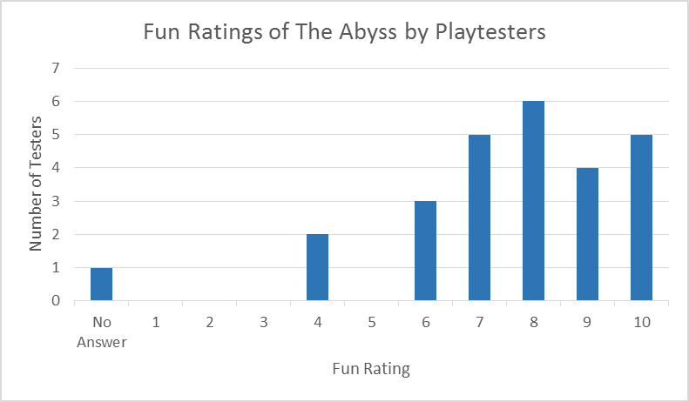
What was fun and what was not fun?
In general, testers seemed to think that the difficulty of the levels and enemies was both fun and not fun, and they all enjoyed surviving through the waves. They also enjoyed the arcade-like experience that the game provided.
Average Fun Rating: 7.8 of 10

Slide 5
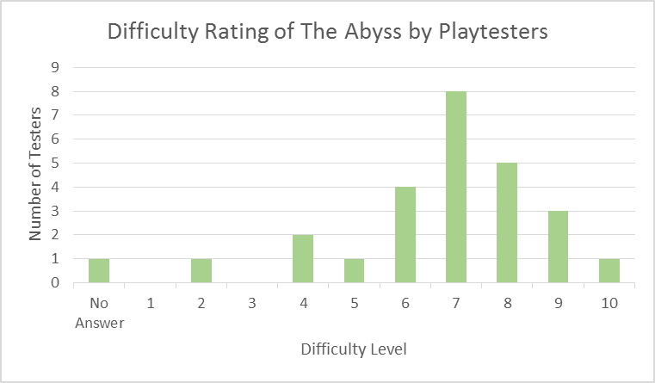
What was difficult and what was easy?
Testers thought the controls were easy to handle and the game concept easily understood. Most testers that were also Casual Gamers thought the difficulty of the levels increased too quickly from Level 1 to Level 2. They all seemed to agree that the side crabs were the most difficult enemy.
Average Difficulty Rating: 6.88 of 10

Slide 6
Final Scores and Death Count
Many Testers did not remember their score
Testers with lower scores did not finish the game
Players understood the scoring system, but most were too focused on defeating enemies to give it attention
Even distribution of death count
No players beat the game without dying

Slide 7
Features
Weapons
Players enjoyed the laser a lot
Players suggested the different torpedo upgrades to add greater diversity to gameplay
HUD
Testers thought HUD elements were succinct, non-distracting, and easy to understand
Some testers did not immediately understand certain HUD elements
Enemies
Players enjoyed the enemy design and animations
Testers struggled the most with the eels and side crabs

Slide 8
Final Thoughts
Favorites
Testers loved using the laser
Players were split on game difficulty. Some wanted more difficulty and others less
The players that disliked the difficulty struggled with the learning curve from level 1 to 2
Additions
Players wanted more levels
Players wanted more power-ups
Players wanted background music behind the sound effects

